Slide 1
Efficient Word2Vec Vectors for Sentiment Analysis to Improve Commercial Movie Success
Yash Parikh (U13CO108)
Abhinivesh Palusa (U13CO057)
Kasthuri Shravankumar (U13CO075)
Guided By
Dr. Rupa G. Mehta
Dr. Dipti P. Rana
COED, SVNIT

Slide 2
Outline
Introduction
Preprocessing
Gross Profit Prediction Model
Review Model
Proposed approach
Conclusion and Future Work

Slide 3
Introduction
Movie Industry
Problem of producers
Predict the gross amount
Change the marketing strategy based on changing gross
Proposed Solution
Predict the gross firstly on the attributes available
Predict the gross incrementally based on user reviews in chunks

Slide 4
Problems with existing solutions
Gross Prediction models are mostly static and don’t focus on improving them
Reviews predicted are after the movie release just for analysis
Review analysis using Sentiment analysis take considerable time and space for prediction to give better results.

Slide 5
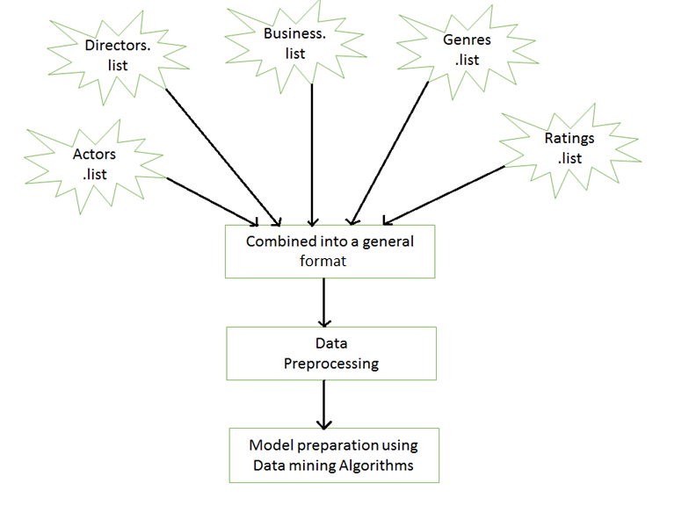
Gross Profit Prediction Model
Notes:
When Apriori is used for heavy datasets in telecommunication and census data, (where the length of frequently occurring patterns is high), the performance of these algorithms degrades remarkably.

Slide 6
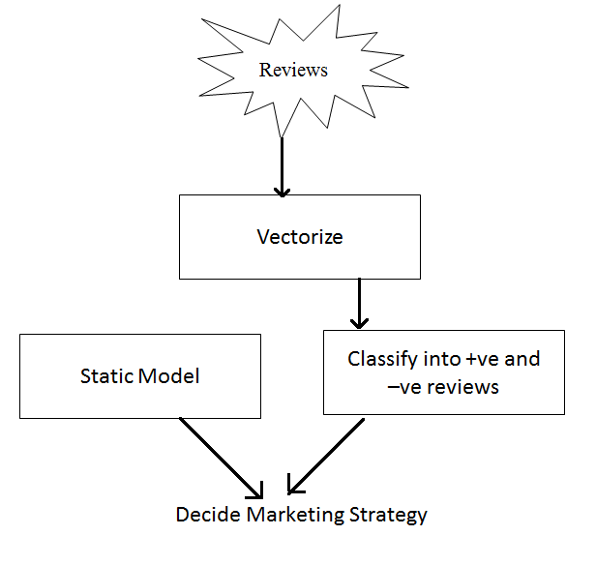
Review Model Preparation

Slide 7
Data Collection and Preprocessing
Data Collection
Open source data available from imdb.com
Two new derived attributes prepared
Actors_fb_likes = Actor_1_fb_likes + Actor_2_fb_likes + Actor_3_fb_likes
Tot_fb_likes = Actors_fb_likes + 0.9*Director_fb_likes

Slide 8
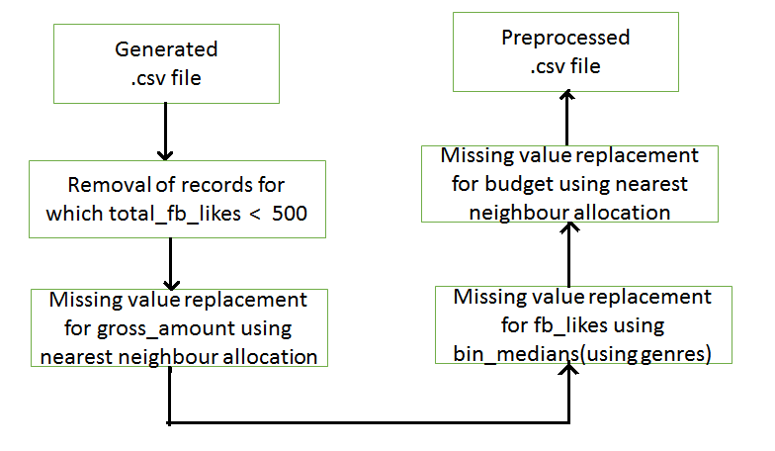
Data Preprocessing Workflow

Slide 9
Preprocessed Data
Preprocessed data contained following useful attributes
Actors_fb_likes
Director_fb_likes
Tot_fb_likes
Cast_total_fb_likes
Imdb_Score
Genre
Budget
Release_year
Movie_fb_likes
Gross

Slide 10
Target Attribute
Nature of relative profit for producers
Norm_Gross = Gross/Budget
Continuous distribution
Distribute into classes
Way 1: Three Classes : [0,1) , [1,5) , Remaining
Way 2: Four Classes : [0,0.5) , [0.5,1) , [1,5) , Remaining
Outliers
Remove instances with Tot_fb_likes < 500
Remove rows with Norm_Gross > 5

Slide 11
Genre Splitting
25 Genres
Previous Accuracy – 51.5%
Accuracy after including all genres – 55.6%
Accuracy after including optimized number of genres – 58%

Slide 12
Our Environment
Ipython
Python 3
Scikit Machine learning Libraries
PyDotPlus
Graphviz

Slide 13
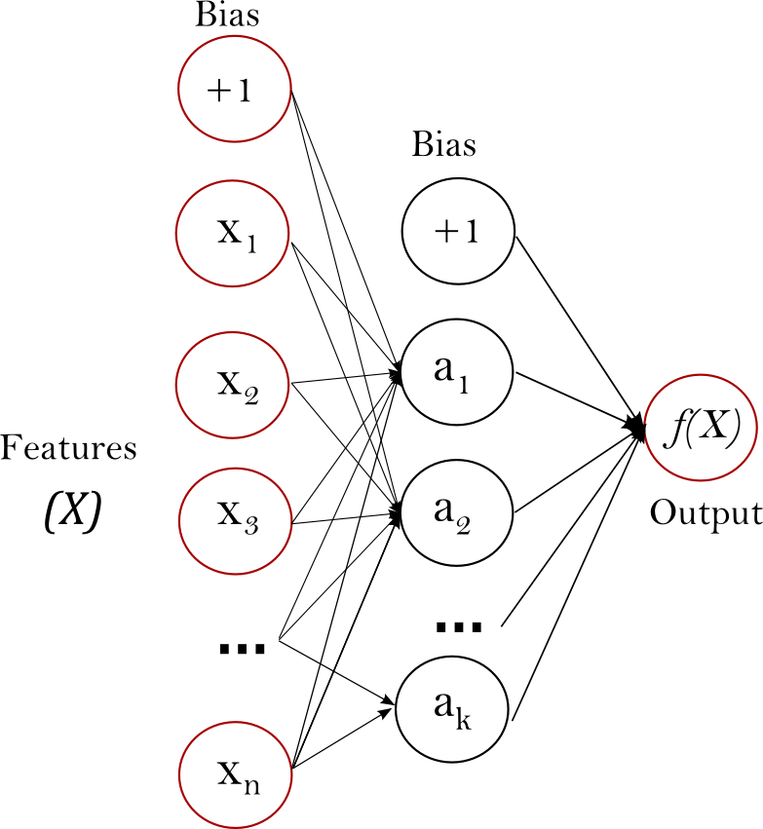
Classifiers: Logistic Regression
Supervised Learning Algorithm
Input is given to Sigmoid(Probability) function
Artificial Neural Networks (ANN)

Slide 14
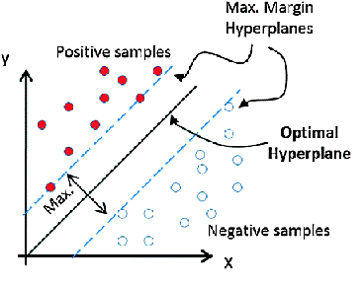

Classifiers(Continued…) Support vector machine(SVM)
SVM with linear classification
Naive Bayes
“Naive” assumption

Slide 15
Classifiers(Continued…)
Basic Decision Tree – Splits the data into two or more sub populations based on a splitter (Gini Index)
Random Forest – Grow multiple trees
Sample dataset – randomly with replacement
Vote System – majority voted class as final value
Gradient Boosting
Weak learner to Strong Learner
selection of sample is done more intelligently.
After the previous sample is trained and tested, the new sample training concentrates more on wrongly predicted rows.

Slide 16
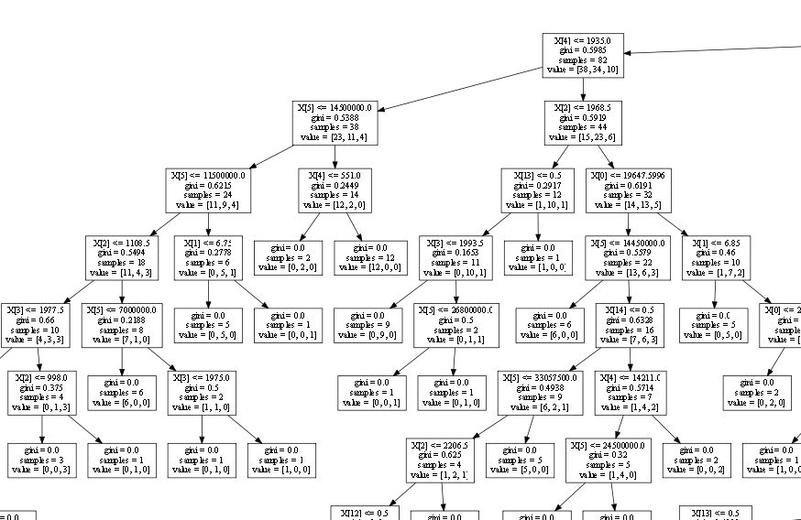
Visualizing Decision Tree (A part of it)

Slide 17
Comparing Accuracies
 | Three Classes [0-0.5, 0.5-1, 1+] | Two Classes [0 – 1, 1 + ]
Decision Tree | 60.62% | 76.37%
Random Forest | 67.72% | 78.74%
Gradient Boosting | 66.14% | 77.95%
Gaussian Naïve Bayes | 50.39% | 62.99%
Logistic Regression | 56.69% | 59.05%
Support Vector Machine (kernel = ‘linear’) | 53.54% | 62.20%

Slide 18
Sentiment Analysis for Movie Reviews
After predicting the Gross, prior to movie release, there will be trailer release, movie first looks, movie audio launch.
So, people will be giving reviews on all the above things and these reviews have to be analyzed.
We use sentiment analysis for this purpose and try to convert words into vector space models.

Slide 19
What are Vector Space Models ?
A word or a sentence cannot be given as an input to any ML algorithm and it has to be converted into a datatype representation the algorithm understands.
So we convert the word(s) into different types of mathematical representations or embedding or vectors and these are known as vector spaces spread across dimensions.

Slide 20
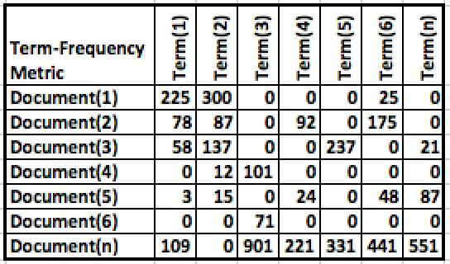
Term Frequency (tf)
Term frequency is nothing but the respective word count in respective documents.
Fig. Example to demonstrate term frequencies

Slide 21
Inverse Document Frequency (idf)
Document Frequency is the ratio of number of documents in which a word occurs to total number of documents.
Inverse Doc. Freq. is reciprocating the Doc. Freq. and applying log to the obtained number so that the most frequently occurring terms will automatically be given less weights.

Slide 22
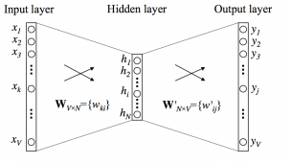
Word2Vec Representations
Word2Vec brings in context of a word and represents word vectors in a more intelligent manner.
All the words initially represented using one-hot encoded representation and are fed into neural network.
Fig. Demonstration of internal w2v

Slide 23
Word2Vec Models (CBOW and Skip-Gram)
There are two main word2vec models: Continuous Bag of Words (CBOW) and Skip-Gram.
In the CBOW model, we predict a word given a context (a context can be something like a sentence).
Skip-Gram is the opposite: predict the context given an input word.

Slide 24
Word2Vec Models (CBOW and Skip-Gram)
Let us consider the following sentence as corpus - ‘the quick brown fox jumped over the lazy dog’.
(context, target) pairs would be : ([the, brown], quick), ([quick, fox], brown), ([brown, jumped], fox), ...
(input, output) pairs would be : (quick, the), (quick, brown), (brown, quick), (brown, fox), ...

Slide 25
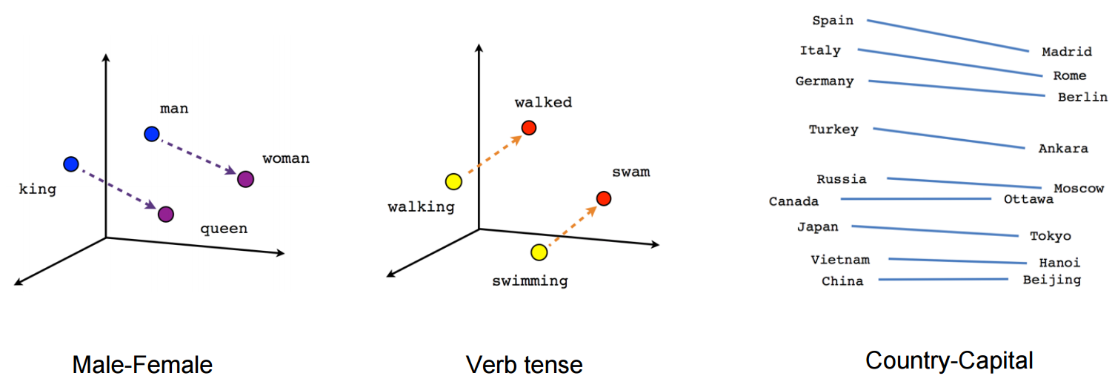
Word2Vec Visualization Examples

Slide 26
Mean Embedding Vectorizer on word2vec
In our dataset each document is represented as one row and so all words in the document are considered and mean of all word vectors are taken.
This makes dimensions of each document(row) will be equal to dimension of each word vector.
These documents completely converted are fed as input to a classifier.

Slide 27
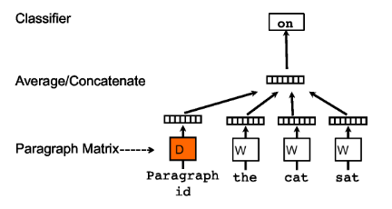
Doc2Vec
Paragraph Vectors
Two Types
Distributed Memory
Distributed Bag of Words
Advantages
Order of words recorded
Semantics captured in a better way
Fig. Framework for learning paragraph vector[4]

Slide 28
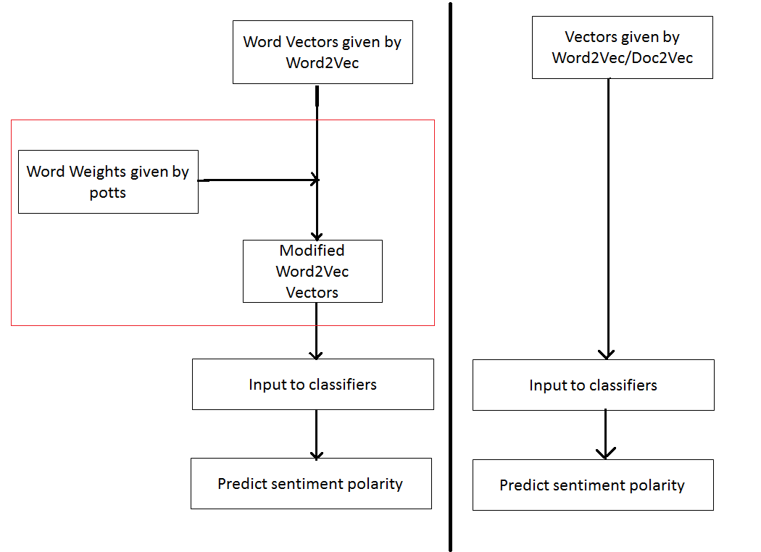
Proposed Approach
Traditional Word2Vec/Doc2Vec Approach
Modified Approach

Slide 29
Proposed Approach
Only step is multiplying word vectors by their scalar weights
No significant time taken.
Time complexity same as Word2Vec
Very less running time as compared to Doc2Vec
Word Vectors take the same memory needed to store as before
Space complexity remains same
No need to store any additional vectors like paragraph vectors in Doc2Vec

Slide 30
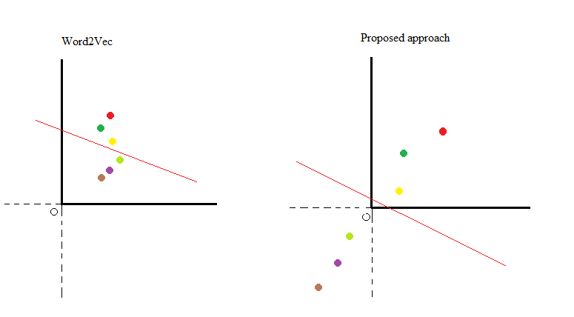
Example
The movie was good.
The movie was great.
The movie was extraordinary.
The movie was bad.
The movie was worse.
The movie was the worst I had seen till date.
Polarity Weights:
good 0.00664930290608
great 1.09468232801
extraordinary 1.49577402122
bad -1.46371254094
worse -1.85024877462
worst -2.55498408869

Slide 31
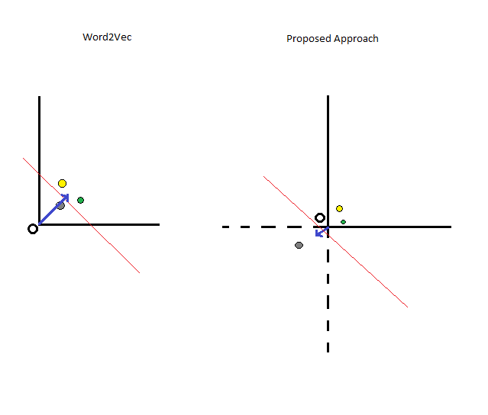
Another Example
The event was so good that it is going to hold me back from the theatres
The trailer was so good that I was half-asleep.
Polarity Weights:
good 0.00664930290608
back -0.0111627460234
half-asleep -1.89107583567

Slide 32
Running Times comparison
 | tf | tf-idf | W2v (cbow) | w2v- mod (cbow) | w2v-pol (cbow) | w2v(sg) | w2v- mod(sg) | w2v-pol(sg) | d2v | D2v (cbow)
Vector -ization time | 6.423s | 9.957s | 171.92s | 171.92 + 90s | 171.92 + 90s | 891.71s | 891.71s + 63s | 891.71s + 63s | 1837.6s | 5224.2s
RFC | 7.857s | 10.237s | 3.583s | 3.921s | 2.899s | 3.827s | 2.813s | 3.415s | 4.377s | 5.896s
DT | 33.72s | 49.02s | 4.780s | 5.784s | 6.324s | 5.724s | 5.421s | 6.454s | 6.606s | 7.675s
GBC | 0.979s | 3.126s | 2.212s | 1.599s | 1.578s | 1.474s | 1.425s | 1.595s | 2.263s | 2.368s
LR | 5.886s | 2.078s | 1.627s | 0.849s | 1.170s | 0.834s | 0.629s | 0.459s | 1.101s | 2.356s
SGD | 1.665s | 0.142s | 0.143s | 0.118s | 0.086s | 0.090s | 0.136s | 0.105s | 0.082s | 0.190s
MNB | 0.307s | 0.108s | - | - | - | - | - | - | - | -
LSVM | 5.160s | 0.628s | 14.244s | 6.087s | 4.514s | 1.040s | 0.682s | 0.461s | 16.330s | 13.157s

Slide 33
Accuracy Comparison
 | tf | tf-idf | w2v (cbow) | w2v-mod (cbow) | w2v-pol (cbow) | w2v (sg) | w2v-mod (sg) | w2v-pol (sg) | d2v | d2v (bow)
RFC | 78.05% | 77.62% | 74.18% | 83.08% | 84.98% | 78.05% | 84.75% | 86.33% | 73.34% | 71.81%
DT | 72.27% | 70.94% | 67.09% | 77.1% | 78.78% | 71.16% | 79.02% | 80.78% | 66.22% | 63.76%
GBC | 72.43% | 72.24% | 72.80% | 81.97% | 84.38% | 76.48% | 83.7% | 86.60% | 72.74% | 69.90%
LR | 85.39% | 88.09% | 85.29% | 88.09% | 88.55% | 86.43% | 83.53% | 87.48% | 86.24% | 88.62%
SGD | 83.73% | 87.8% | 80.18% | 87.98% | 88.58% | 85.94% | 86.91% | 87.34% | 79.44% | 86.46%
MNB | 82.94% | 84.02% | _ | _ | _ | _ | _ | _ | _ | _
LSVM | 82.80% | 86.16% | 85.34% | 88.1% | 88.68% | 87.28% | 88.74% | 89.01% | 86.22% | 88.708%

Slide 34
 | Doc2Vec | Our approach on Word2vec (LSVM classifier)
Stanford dataset | 88.708 | 89.01
Pang Lee Dataset | 86.75 | 87.4

Slide 35
Conclusion and Future Work
Proposed Approach
Sentiment Classification done in very less time than Doc2Vec ☺
Sentiment Classification takes the same space as in Word2Vec ☺
Improved Accuracy than Word2Vec and comparable to Doc2Vec ☺
Producers can improve marketing strategies by analyzing reviews in chunks
Distributers can plan their purchase better
Future Work
Include reviews from all social media like YouTube, Facebook, Twitter, etc.
Extend to distributed systems

Slide 36
References
[1] Maas, Andrew L. et al. “Learning Word Vectors for Sentiment Analysis.” ACL (2011).
[2] Rajaraman, A.; Ullman, J. D. Mining of Massive Datasets. Cambridge University Press,
[3] Tomas Mikolov, Kai Chen, Greg Corrado, and Jeffrey Dean. Efficient estimation of word representations in vector space. ICLR Workshop, 2013.
[4] Quoc Le, Tomas Mikolov; Distributed Representations of Sentences and Documents, Proceedings of the 31st International Conference on Machine Learning, PMLR 32(2):1188-1196, 2014.
[5] Potts, Christopher. “On the negativity of negation.” (2011).
[6] Bo Pang, Lillian Lee, and Shivakumar Vaithyanathan, Thumbs up? Sentiment classification using machine learning techniques, Proceedings of EMNLP, pp. 79--86, 2002.
[7] Malouf, Robert (2002). A Comparison of Algorithms for Maximum Entropy Parameter Estimation. Sixth Conf. on Natural Language Learning (CoNLL). pp. 49–55.
[8] Han J, Kamber M, Pei J (2006) Data Mining: Concepts and Techniques, Second Edition (The Morgan Kaufmann Series in Data Management Systems), 2nd ed.. Morgan Kaufmann, San Francisco, CA, USA.
[9] Vidushi Sharma, Sachin Rai, Anurag Dev, a Comprehensive Study of Artificial Neural Networks, Volume 2, Issue 10, October 2012.
[10] Andrew Ng, Machine Learning Yearning, Draft Version 0.5, 2016.
[11] Pang, B., Lee, Lillian, a Sentimental Education: Sentiment Analysis Using Subjectivity Summarization Based on Minimum Cuts. In: Proc. of the 42nd ACL, pp. 271–278, 2004.

Slide 37
Thank You

